Slide 1

Welcome!
Cookie Business Family Meeting

Slide 2

What we will cover…
New Mascot & Theme
Cookie Program Overview
Parent/Guardian Participation
Ways to Sell
Troop/Individual Goals
Communication + Cookie Schedule
Finances
Online Family Cookie Responsibility Form
Online Cookie Systems
Thank You! + Q&A

Slide 3



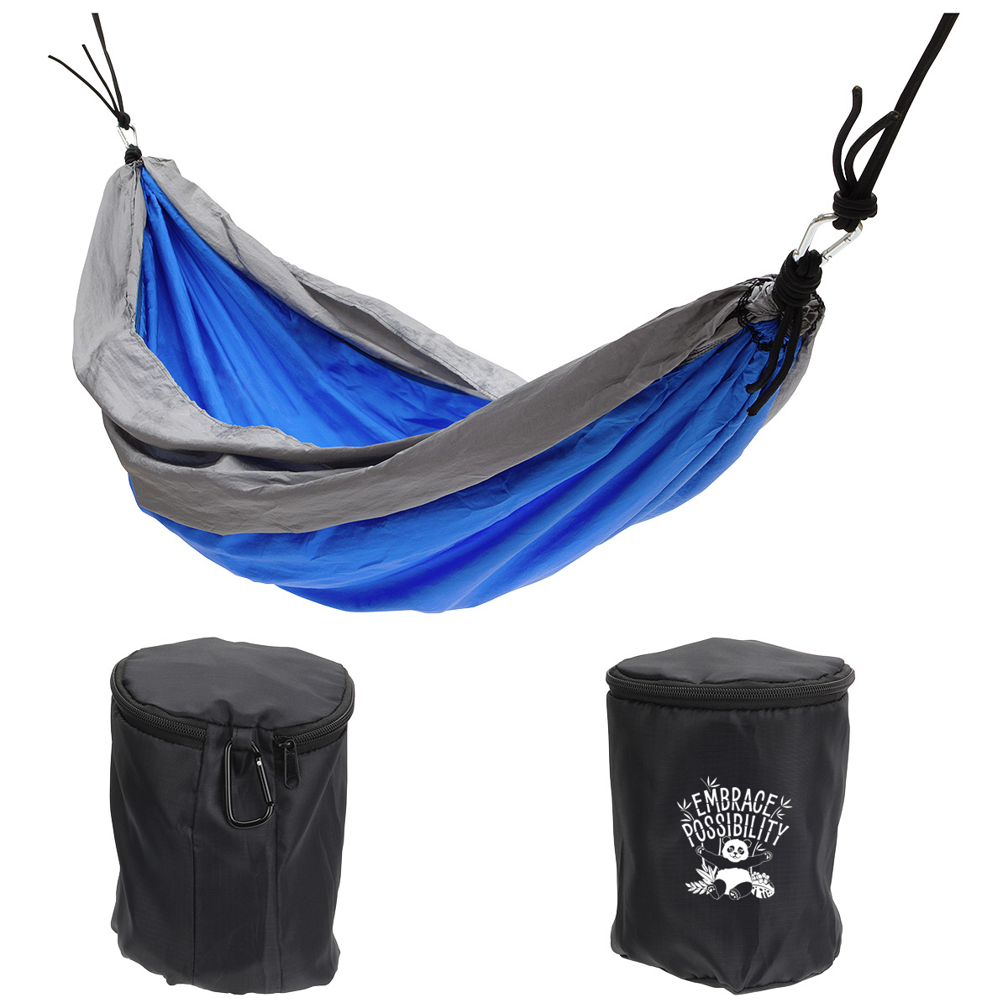
NEW FOR 2025
New Cookie Mascot Noodles the Panda & Theme
Earn rewards featuring Noodles the Panda

Slide 4

Cookie Program Overview
Largest girl-led entrepreneurial program in the world
Gives Girl Scouts the opportunity to power new, unique, and amazing experiences while also learning essential life skills
The troop receives $1 in proceeds per package sold
All proceeds from the Cookie Program stay local!

Slide 5

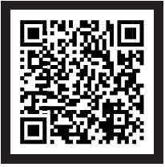
Add slide on Cookie Central
Cookie Central is your online, one-stop hub for all things cookies! Use your mobile device’s camera to scan the QR code here or visit CookieCentral. From there, you can:
Access online resources
Digital Cookie Help Center for Families
Printable resources (thank you cards, order card, door hangers, & more)
View details on rewards, how to use Cookie Credits & more!

Slide 6


Your Cookie Materials
Family Guide
Cookie Order Card
Money envelope
Rewards Flier
More printable resources, like the business cards and door hangers, can be found on Cookie Central
All items can also be found on
Cookie Central!

Slide 7

Your Girl Scout Cookie Favorites Are Back!
Nine cookie varieties
All varieties are $6 per package
View nutritional & allergen information on Cookie Central
Information also available on your order card

Slide 8

Ta-ta Toast-Yay!

Slide 9

Engaging Parents/Guardians:
Troop Support
Family involvement is key to troop success, so get your parents/guardians help to support the troop this cookie season...
Being an adult presence at cookie booths
  Review our Cookie Booth Policy
Help track cookie inventory for the troop and/or Girl Scouts
  Reference the Digital Cookie Help Center for Families, View your Cookie Totals section, for resources
Collect money and turn in to the troop on a weekly basis & keep the receipts of money exchanges
Talk to your Girl Scouts about their goals
  What rewards do they want to earn?
  How do they like to participate in the sale?
  Review the Family Entrepreneur pin guidelines, which features goal setting information

Slide 10

Ways to Sell
There are many ways for your Girl Scout to sell cookies, do your research & choose the option(s) that work best for your family and Girl Scout
  Navigating Ways to Participate: Tips for Troop Leadership
Notes:
Check out your Family Guide for more information on the ways to sell.

Slide 11
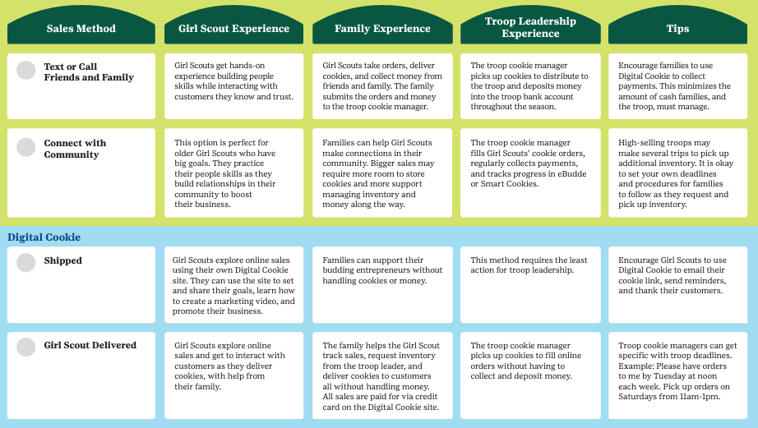
Ways to
Sell
Text or Call Friends and Family
Connect with Community
Digital Cookie sales:
  Shipped
  Girl Scout Delivered
Notes:
Check out your Family Guide for more information on the ways to sell.

Slide 12
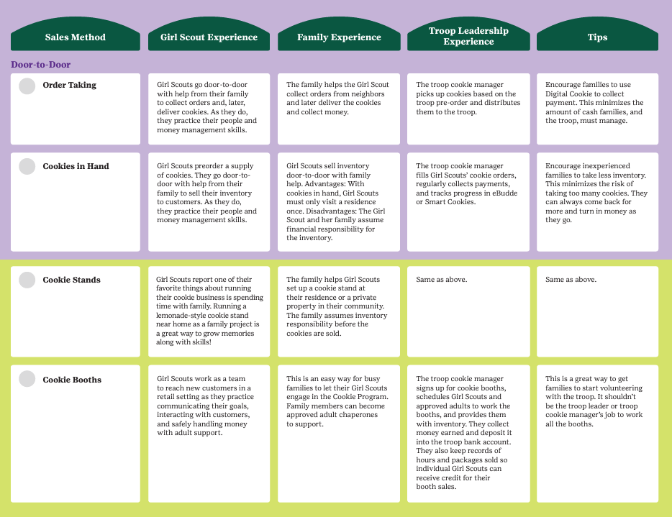
Ways to
Sell
Door to Door:
  Order Taking
  Cookies in Hand
Cookie Stands
Cookie Booths
Notes:
Check out your Family Guide for more information on the ways to sell.

Slide 13

Troop & Individual Goals
Troop Brainstorming Session: Cookie Proceeds
  How should we use them?
  What will that cost?
  How many packages do we need to sell to reach our goal?
Individual Girl Scout Goals
  Is that goal achievable?
  How do you plan to reach it?
  What skills do you want to develop?
  Review last year’s goals (if they sold)
Be sure to discuss your troop's cookie donation options

Slide 14
Cookie Communication & Schedule
Contact info and preferred method
Family Return Date: final day for Girl Scouts to return cookies to the troop
Troop cookie schedule
Key Dates for 2025
Troop Initial Order Jan. 24
Pre-sales & Online sales Feb. 12
Cookie & Booth Go Day Feb. 21
Cookie Sale Ends Mar. 30
Troop Reward Deadline Apr. 6
Girl Rewards Arrive Late May
Notes:
How does the troop leader want to be contacted by their Girl Scout families?
Family Return date is so important to make sure all members of the troop are on the same page. Don’t forget to write this on your Family Guide so your caregivers can reference it later on.
Talk about your troop cookie schedule: when are Troop Leaders available to pick up more cookies from a cupboard? When can Girl Scouts expect to visit their Troop Leaders home to pick up those cookies? What caregivers are helping with these efforts? And more.

Slide 15

Finances + Family Responsibility
All cookies are $6 per package
Turn in cookie money weekly
You are responsible for cookies not returned to the troop by the Family Return Date
Troop is responsible for leftover inventory at end of sale
  Reach out if you have too much extra cookie inventory!
Notes:
Discuss how payment will be collected from families throughout the sale? Remind families that they must turn I 50% or more of total money due to the troop before they can receive more cookies from the troop cookie manager. Credit card payments can be taken through Digital Cookie, at no charge for the troop! Credit card sales are credited to your Girl Scout in the system.

Slide 16
Online Family Responsibility Form
Required for participation in the program
Must be received before cookies are given to families
Can be found on Cookie Central
Enter my email address & troop number
You & I will both receive email confirmation

Slide 17

Digital Cookie
Digital Cookie is the online platform that Girl Scouts and caregivers use for digital cookie sales.
All Girl Scouts and their families will get access to Digital Cookie on Feb 1
Use your Digital Cookie account to:
  set up your online sales link (shipped cookie orders, in-person delivery)
Share this link by email, text, social media, or even parent/guardian workspaces

Slide 18

What’s New for 2025
Mobile App Updates:
You can now accept credit card, Venmo and PayPal as payment for in-person sales using the mobile app.
  Be sure to download the latest version of the app!
Quicker customer check-out process
  No longer required to fill in their name, address, and zip code
Notes:
GSUSA has made many enhancements on the Digital Cookie platform including:

Slide 19
Digital Cookie
Resources
Family Cookie Guide
Digital Cookie Help Center for Girl Scouts and Families on Cookie Central
Help section in the Digital Cookie site with tip sheets & videos
Email us at girlscouts@girlscoutsrv.org or call us at 800-845-0787 for additional assistance!

Slide 20

Thank You!
Questions?

